Slide 1
01
SOFTWARE
PROJECT
LAB
NAME : EFFAZ RAYHAN
ROLL : BSSE 1501
SUPERVISOR : DR. MD. NURUL AHAD TAWHID

Slide 2
Table of Contents
Project Description
Project Motivation
Working Methodology
Technology
Progress
Further Plan
Challenges

Slide 3

PROJECT
DESCRIPTION

Slide 4
Project Description
Connecto
A Client-Server Based Chatting Application
The secure chat room application is a client-server based chat system that enables multiple users to communicate securely.

Slide 5
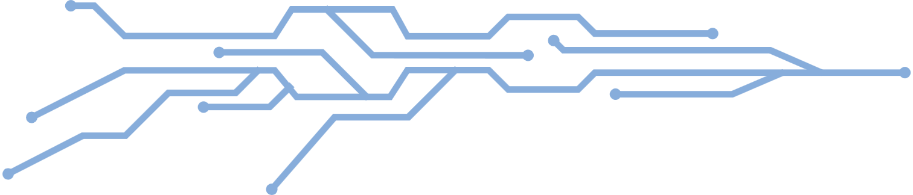
Project Description
Secure
03
HIGHLIGHTED
FEATURES
Chat room
Client-Server

Slide 6
Project Description
Chat room
WHY?
Secure
Client-Server

Slide 7
Project Description
Chat room
HOW?
Secure
Client-Server

Slide 8
ANSWER TO WHY
PROJECT
MOTIVATION

Slide 9
Project Motivation
Growing Need for Secure Communication
Simplified and Intuitive Interaction
Cybersecurity threats such as data breaches and unauthorized access have highlighted the vulnerabilities of traditional communication systems. Connecto aims to address this concern by integrating robust encryption and secure user authentication, ensuring that user data and messages remain private and tamper-proof.
By providing a command-based user interface, Connecto caters to users seeking a lightweight, efficient alternative to resource-intensive graphical interfaces. This approach supports seamless navigation and interaction, particularly for those comfortable with terminal-based systems.
Support for Collaborative Spaces
Accessibility and Availability
Modern workflows often require team-based discussions in dedicated environments. Connecto’s chatroom management feature facilitates real-time collaboration, offering a persistent and structured platform for discussions.
Connecto incorporates features such as online availability checking, enabling users to see who is active and facilitating instant communication. This real-time connectivity fosters productivity and minimizes delays.

Slide 10
ANSWER TO HOW
WORKING
METHODOLOGY

Slide 11
WORKING METHODOLOGY
EASY TO
OPERATE
TO ESTABLISH COMMUNICATION
BETWEEN
CO-WORKERS AND FRIENDS
WORKS ON
SAME LAN
CHATTING APPLICATION
NO INTERNET
DEPENDENCY
SECURE

Slide 12
WORKING METHODOLOGY
SOCKET PROGRAMMING
SHA-512 HASHING ALGORITHM
TERMINAL BASED
EASY USER INTERFACE

Slide 13
TECHNOLOGY

Slide 14
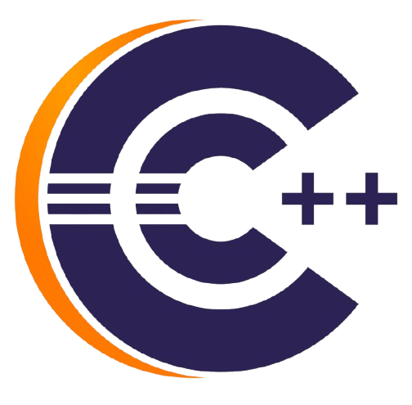

TECHNOLOGY
C++ PROGRAMMING LANGUAGE
SOCKET PROGRAMMING

Slide 15
PROGRESS

Slide 16
PROGRESS
DASHBOARD
SIGNUP
LOGIN
USERNAME
PASSWORD
USERNAME
PASSWORD
DATABASE
DATABASE
(IF EXIST)
(IF !EXIST)
HASH
( SHA-512 )
GET TOKEN
GENERATE
TOKEN
HASH
( SHA-512 )
MATCHES IN FILE
STORED IN FILE
SIGNUP SUCCESSFUL
LOGIN SUCCESSFUL

Slide 17
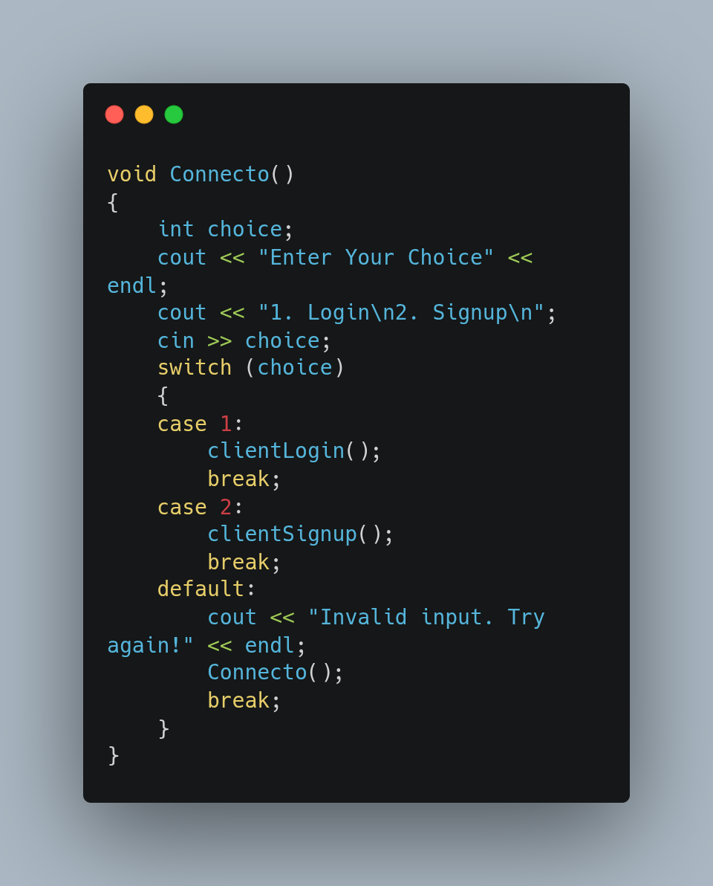
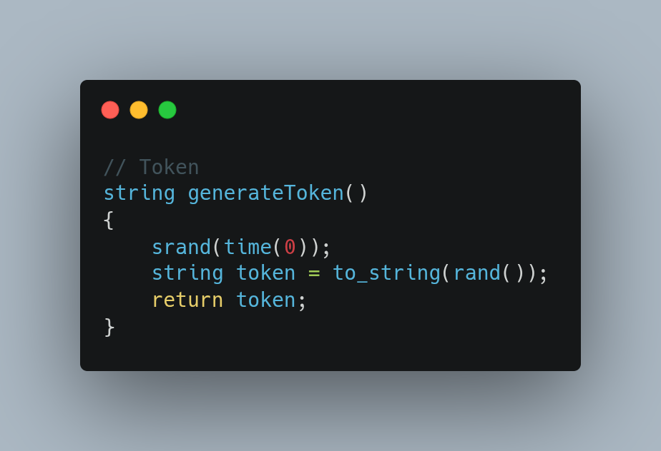
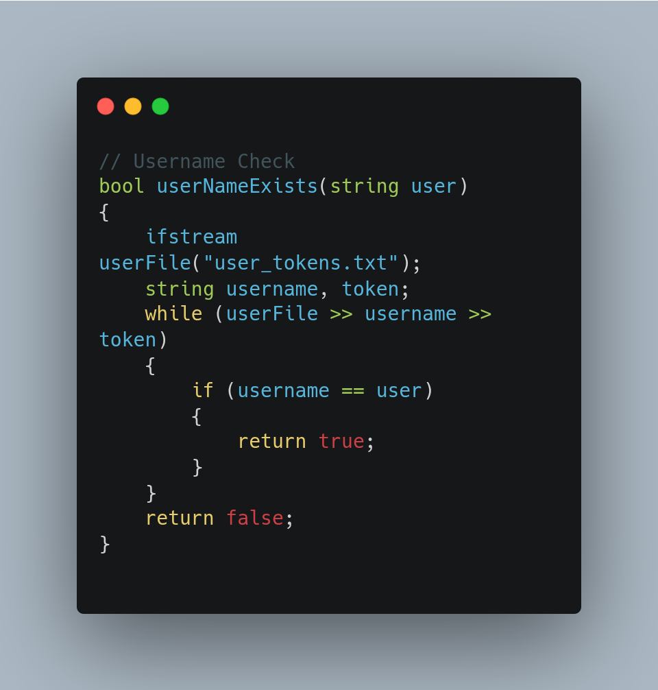
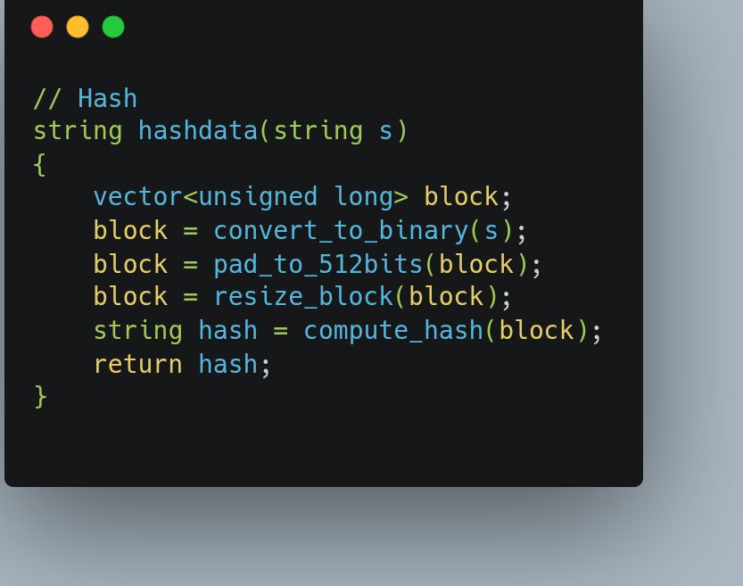
PROGRESS

Slide 18
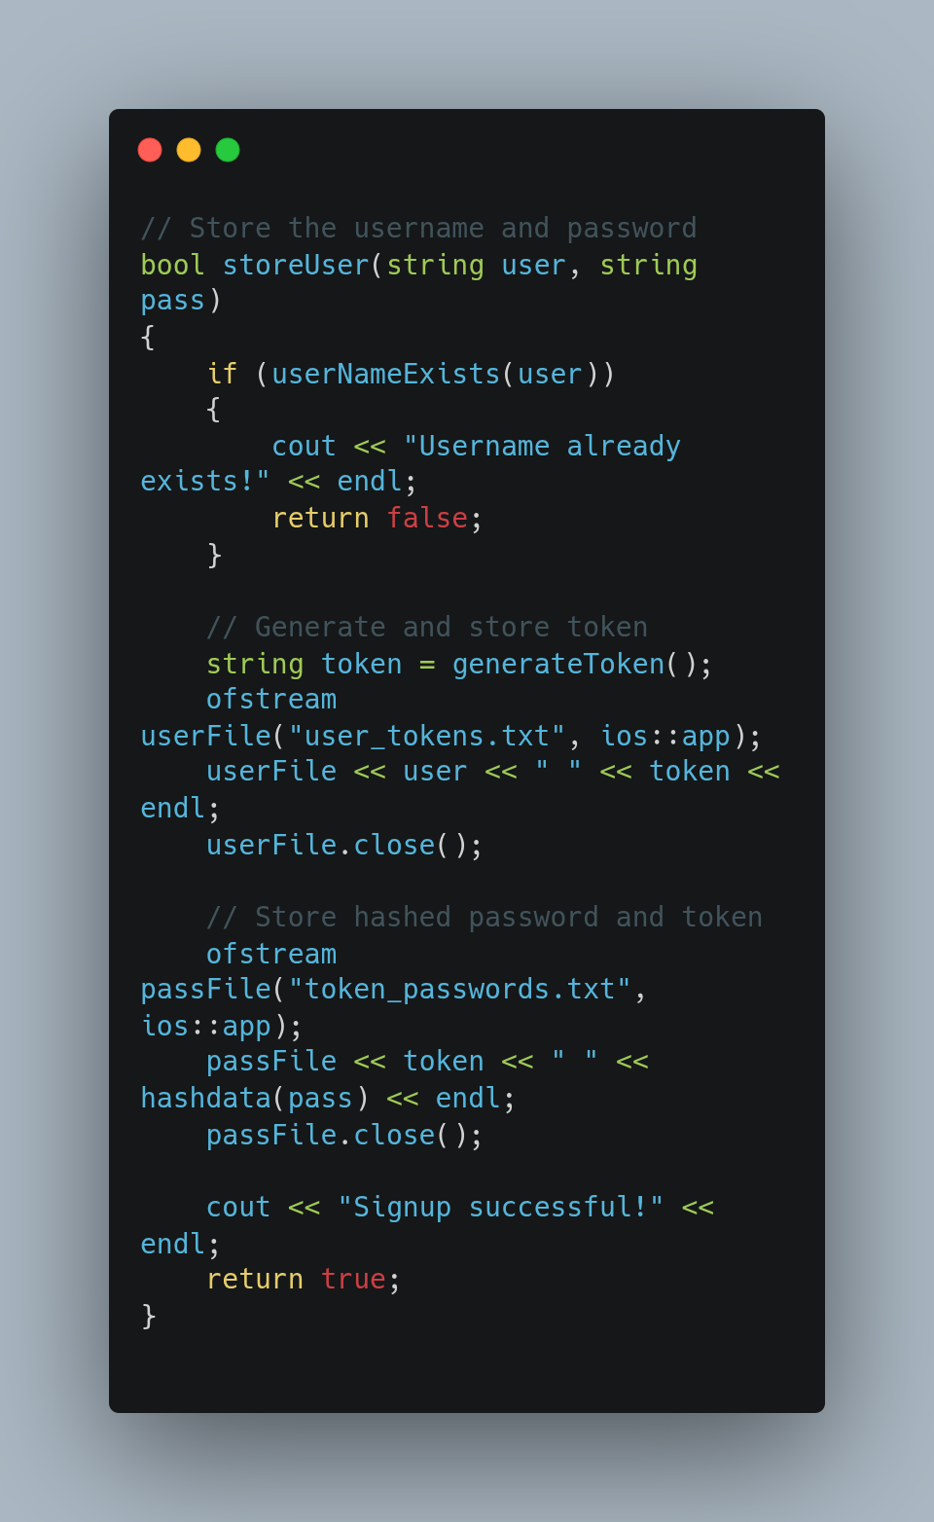
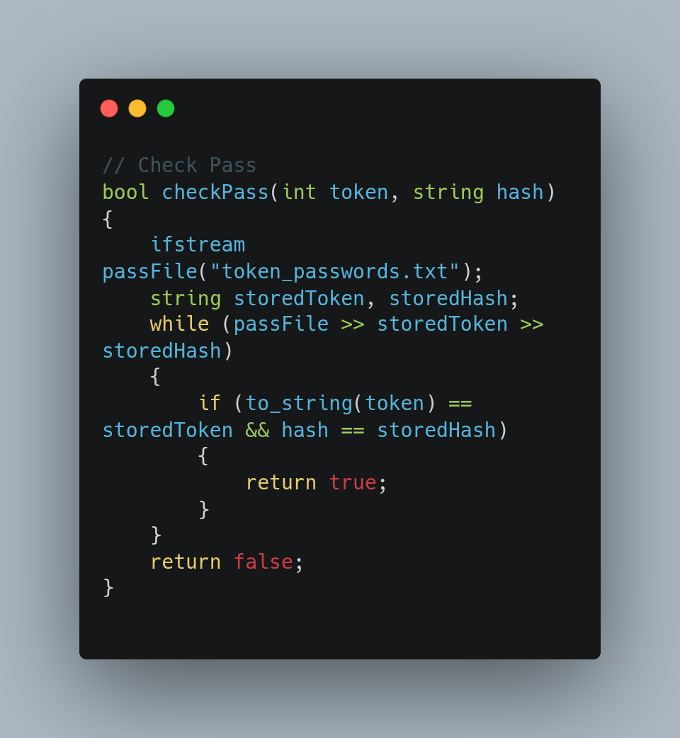
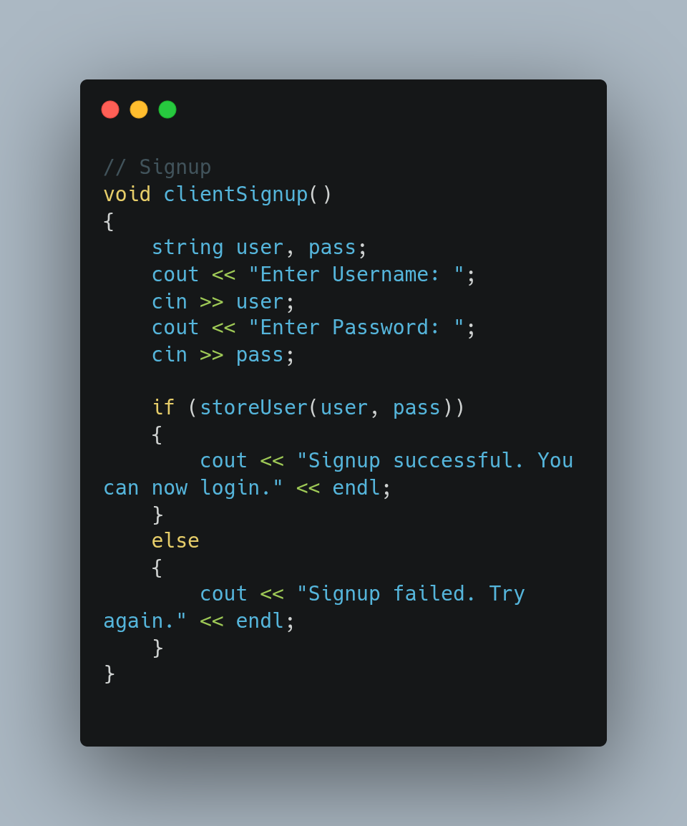
PROGRESS

Slide 19
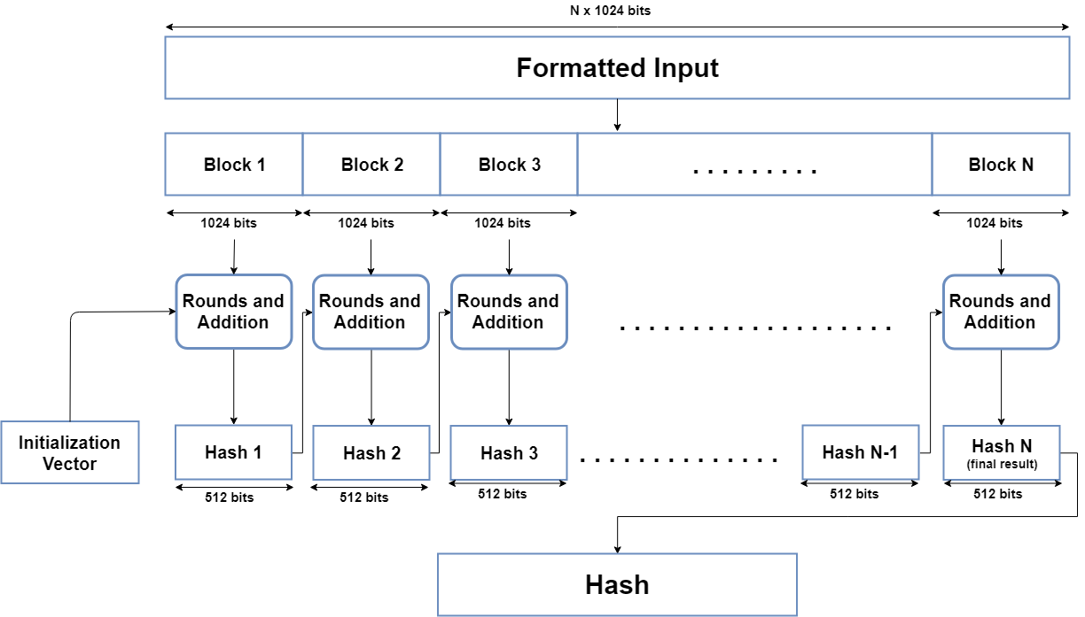
PROGRESS
SHA
512

Slide 20
FURTHER PLAN

Slide 21
FURTHER PLAN
ONLINE AVAILABILITY CHECKING
MULTIPLE CHAT ROOMS
OTHER
FEATURES
PASSWORD SECURITY LEVEL CHECKING

Slide 22
FURTHER PLAN
LOGIN SUCCESSFUL
CREATE CHAT ROOM
JOIN CHAT ROOM
ROOM ID
ROOM PASSWORD
ROOM ID
ROOM PASSWORD
GENERATE ROOM ID
CHECKED IN SERVER LOG
HASH
( SHA-512 )
HASH
( SHA-512 )
STORED IN SERVER LOG
MATCHED
LOGGED INTO CHATROOM

Slide 23
CHALLENGES

Slide 24
CHALLENGES
CHALLENGES SO FAR
FURTHER CHALLENGES
First Time Working on a Big Project
Explore Socket Programming
Study encryption and decryption algorithms
Implement RAW SHA-512 code
Learn MultiThreading
Implement Secure Encryption Algorithm For Secure Communication
Add Password Security Level Checking
Merge The Dashboard with server-client

Slide 25
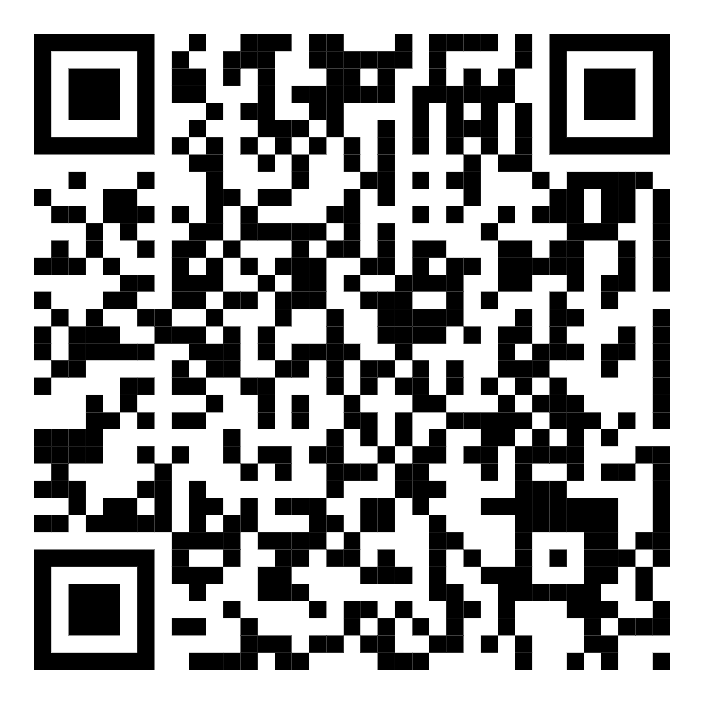
THANK YOU
NAME : EFFAZ RAYHAN
ROLL : BSSE 1501
MY GITHUB REPOSITORY :
https://github.com/effazrayhan/spl_one

